Slide 1
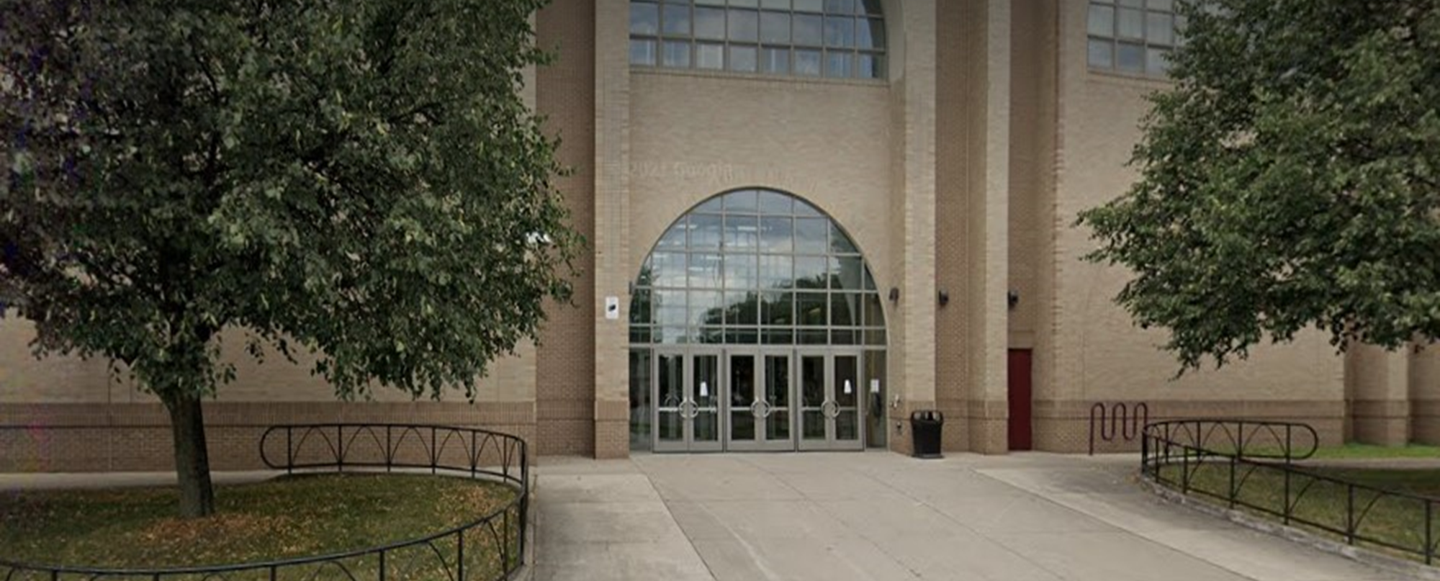
Title I Parent Meeting
School of the Arts
2025-2026
Notes:
Greetings, families.
The purpose of this PowerPoint is to provide you with information regarding Title I activities at your child’s school.

Slide 2
What is Title I?
Part A –
Elementary and Secondary Education Act, 1965
Provides additional funding to schools to
    support additional learning opportunities for students;
    ensure that all students have the chance to receive a high-quality education;
    increase family engagement
Notes:
Title I is part of the United States’ current version of the Elementary and Secondary School act. It is now called the Every Student Succeeds Act, or ESSA.
Title I is funding provided by the United States Department of Education in order to ensure that all students have access to a high quality education. The funds can be used to support additional learning opportunities for students and to increase parent/family engagement.

Slide 3
Administration of Grants
Rules of thumb:
Expenditures must be reasonable and necessary to carry out the goals of the grant
Allowable under the intent of the grant
Must be in additional to required instructional services provided to students as part of their regular school day
Notes:
Title I funds must be used under the following rules: the funds must be used to carry out the goals of the school’s improvement plan and help the school to meet its improvement goals, and funds must be used to provide students additional learning opportunities above and beyond what they are required to receive as part of their regular ELA, Math, Social Studies and Science instruction, and the funds must be used in “allowable” ways, according to the rules set by the New York State Department of Education.

Slide 4
How are Title I funds used at my school?
Supplemental Instruction
Hiring of additional Reading or Intervention Teachers
Providing after school, Saturday or break programs
Purchasing of additional resources to support student learning (books, software, supplies and materials)
The school should…
Notify parents if their child is participating in extra programs and update parents on their child’s progress
Offer information about the professional qualifications of their child’s teacher
Notify parents on the achievement of their child on NYS assessments
Notes:
Title I funds can be used at schools in many ways to meet student needs. These are some ways that our school uses Title I funds to support student learning. Using Title I funds in these ways helps students to meet grade level expectations and provides students with opportunities to take more challenging classes if needed.
Under Title I, schools are required to provide parents with a variety of information pertaining to how their child is doing in school and whether or not their child is receiving extra supports. The school should notify parents if their child is participating in any additional programming, even if it’s working with the Intervention or Reading Teacher during the day. The school should also be providing parents with reports on how their child is doing in their extra classes. Parents have the right to request the professional qualifications of their child’s teacher; the school will have a list of teachers who are working toward certification available in the main office. The District will notify parents of their child’s achievement on NYS assessments. This usually happens in late August or early September.

Slide 5
How are Title I funds used at my school?
Parent/Family Engagement Activities
Orientations
Open House
Parent Group Meetings
Parent Center Resources
More…
The school should…
Have a parent group and school-based planning team with parents on it
Invite parents to participate activities at the school, including developing school improvement plans
Communicate with parents in the language that the parent prefers
Notes:
Title I funds are also used for the school to host events or activities to involve parents/families in the education of their children. These are some examples of ways that schools use the funds. The District also uses Title I funds to help host Districtwide events that are planned through the District’s Office of Parent Engagement.
Parents have rights under Title I. Some of those include the school making efforts to ensure that parents are represented on school teams such as PTA/PTA or the SBPT. Parents are also required to be invited to participate in events and activities at the school, including helping the school to develop improvement plans. Also, the school and district should be communicating with parents in the language that the parent prefers.

Slide 6
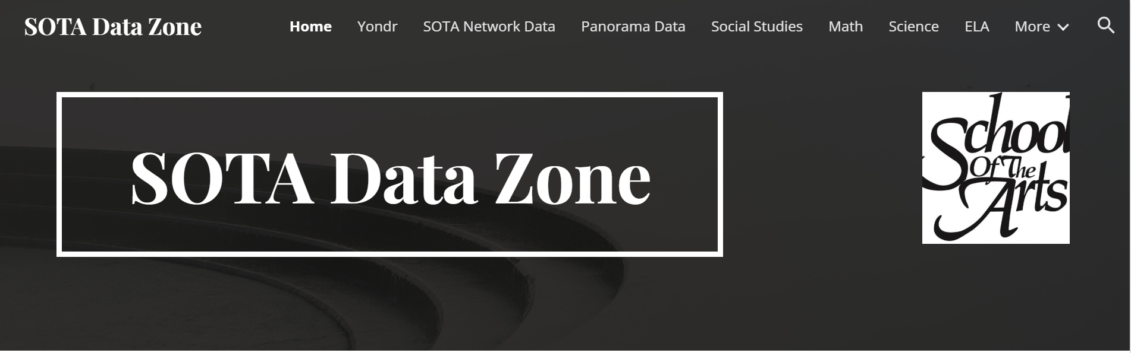
Evidence of Impact
Notes:
Use of these funds is helping our students grow and succeed, and helping our schools improve.

Slide 7

Questions?
Lauren McKoy, Director of Grants for Academic Programs
lauren.mckoy@rcsdk12.org
Keisha Hollomon, Director of Community/Parent Involvement
keisha.hollomon@rcsdk12.org

Slide 8
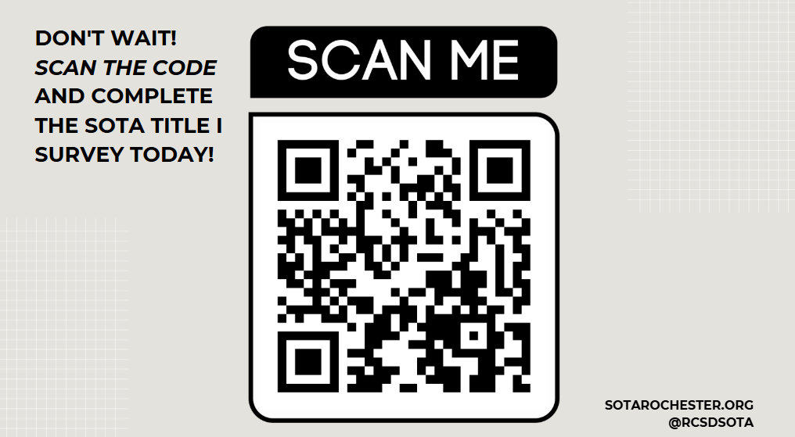
Notes:
Title I funds are also used for the school to host events or activities to involve parents/families in the education of their children. These are some examples of ways that schools use the funds. The District also uses Title I funds to help host Districtwide events that are planned through the District’s Office of Parent Engagement.
Parents have rights under Title I. Some of those include the school making efforts to ensure that parents are represented on school teams such as PTA/PTA or the SBPT. Parents are also required to be invited to participate in events and activities at the school, including helping the school to develop improvement plans. Also, the school and district should be communicating with parents in the language that the parent prefers.

